Slide 1


INSTITUTE : UIE
DEPARTMENT : CSE
Bachelor of Engineering (Computer Science & Engineering)
WEB AND MOBILE SECURITY (Professional Elective-I)
(20CST/IT-333)
TOPIC OF PRESENTATION:
Web Fundamentals – HTML, HTTP.
DISCOVER . LEARN . EMPOWER

Slide 2

Lecture Objectives
In this lecture, we will discuss:
Introduction to Web development. Difference between HTML and HTTP.

Slide 3
HTML (Hypertext MarkUP Language)
HTML is the standard markup language for Web pages.
With HTML you can create your own Website.
HTML - for publishing hypertext on the World Wide Web
Define tags <html><body> <head>….etc
The latest version of HTML is HTML5. There are two main components in HTML language, Tags and Attributes.
Allow to embed other scripting languages to manipulate design layout, text and- graphics
The latest version of HTML is HTML5. There are two main components in HTML language, Tags and Attributes.
For more info: http://www.w3.org/MarkUp/

Slide 4
HTML (Hypertext Markup Language)
Example HTML code:
<html>
<head>
<title>Hello World</title>
</head>
<body bgcolor = “#000000”>
<font color = “#ffffff”>
<H1>Hello World</H1>
</font>
</body>
</html>

Slide 5
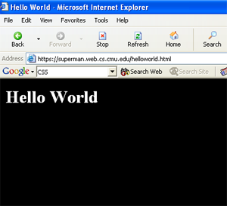
HTML (Hypertext Markup Language)

Slide 6
HTML (Hypertext Markup Language)
Common features
Tables
Frame
Form
Image map
Meta tags
Images, Hyperlink, etc…

Slide 7
HTML (Hypertext Markup Language)
File Extensions:
HTML, HTM
Recent recommendation of W3C is XHTML 1.0 combines the strength of HTML 4 with the power of XML.
XHTML 1.0 is the first major change to HTML since HTML 4.0 was released in 1997
More info: http://www.w3.org/TR/xhtml1/

Slide 8
What is HTTP(HyperText Transfer Protocol)?
Protocol for transfer of various data formats between server and client
Plaintext
Hypertext
Images
Video
Sound
Protocol using which hypertext is transferred over the Web. Due to its simplicity, http has been the most widely used protocol for data transfer over the Web but the data (i.e. hypertext) exchanged using http isn’t as secure as we would like it to be. In fact, hyper-text exchanged using http goes as plain text
It is invented by Tim Berner. HyperText is the type of text which is specially coded with the help of some standard coding language called as HyperText Markup Language (HTML).

Slide 9
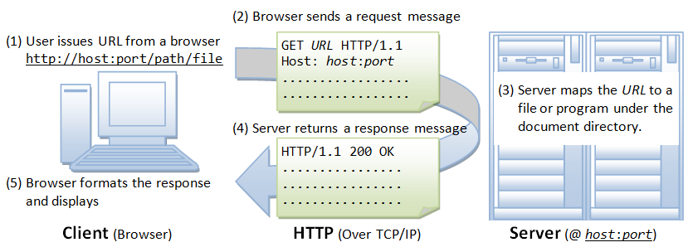

Slide 10
URL
Uniform Resource Locator
Points to a document on a specific server
<scheme> : //<host> :<port> /<path> ;<parameters> ?<query> #<fragment>
scheme
The protocol you are using
host
Host name or ip number
port
TCP port number that protocol server is using
path
Path and filename reference of object on server

Slide 11
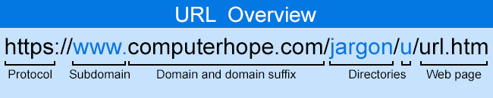
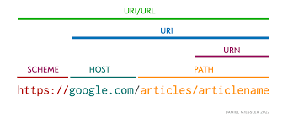

Slide 12
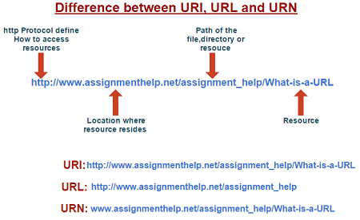

Slide 13
HTTP evolution
HTTP version 0.9 – This was first version of HTTP which was introduced in 1991.
HTTP version 1.0 – In 1996, RFC 1945 (Request For Comments) was introduced in HTTP version 1.0.
HTTP version 1.1 – In January 1997, RFC 2068 was introduced in HTTP version 1.1. Improvements and updates to HTTP version 1.1 standard were released under RFC 2616 in June 1999.
HTTP version 2.0 – The HTTP version 2.0 specification was published as RFC 7540 on May 14, 2015.
HTTP version 3.0 – published in 2022 HTTP version 3.0 is based on previous RFC draft. It is renamed as HyperText Transfer Protocol QUIC (Quick UDP Internet Connections, pronounced quick)which is a transport layer network protocol developed by Google. The overall goal is to reduce latency compared to that of TCP. Think of QUIC as being similar to TCP+TLS+HTTP/2 implemented on UDP.

Slide 14
Features of HTTP
Connectionless protocol: HTTP is a connectionless protocol. HTTP client initiates a request and waits for a response from the server. When the server receives the request, the server processes the request and sends back the response to the HTTP client after which the client disconnects the connection. The connection between client and server exist only during the current request and response time only.
Media independent: HTTP protocol is a media independent as data can be sent as long as both the client and server know how to handle the data content. It is required for both the client and server to specify the content type in MIME-type header.
Stateless: HTTP is a stateless protocol as both the client and server know each other only during the current request. Due to this nature of the protocol, both the client and server do not retain the information between various requests of the web pages.

Slide 15
HTTP can use both non-persistent connections and persistent connections. Non-Persistent Connection: It requires connection setup again and again for each object to send. Persistent connection: It does not require connection setup again and again
The non-persistent connection has connection type 1.0, while the persistent connection has connection type 1.1.
HTTP is similar to the FTP as it also transfers the files from one host to another host. But, HTTP is simpler than FTP as HTTP uses only one connection, i.e., no control connection to transfer the files.
HTTP is used to carry the data in the form of MIME-like format.
HTTP is similar to SMTP as the data is transferred between client and server. The HTTP differs from the SMTP in the way the messages are sent from the client to the server and from server to the client. SMTP messages are stored and forwarded while HTTP messages are delivered immediately.

Slide 16
Differences between HTTP and HTTPS
HTTP stands for HyperText Transfer Protocol and HTTPS stands for HyperText Transfer Protocol Secure.
In HTTP, URL begins with “http://” whereas URL starts with “https://”
HTTP uses port number 80 for communication and HTTPS uses 443
HTTP is considered to be insecure and HTTPS is secure
HTTP Works at Application Layer and HTTPS works at Transport Layer
In HTTP, Encryption is absent and Encryption is present in HTTPS as discussed above
HTTP does not require any certificates and HTTPS needs SSL Certificates
HTTP speed is faster than HTTPS and HTTPS speed is slower than HTTP
HTTP does not improve search ranking while HTTPS improves search ranking.
HTTP does not use data hashtags to secure data, while HTTPS will have the data before sending it and return it to its original state on the receiver side.

Slide 17
References:
Books:
Web Design With HTML, CSS, JavaScript and jQuery Set, 1st Edition, by Jon Duckett.
Hacking Exposed Web Applications, 3rd edition, Joel Scambray, Vincent Liu, Caleb Sima, Released October 2010, Publisher(s): McGraw-Hill
Video Lectures :
1. https://www.youtube.com/watch?v=m5okAKeD184
Reference Links:
https://www.w3schools.com/whatis/
https://www.geeksforgeeks.org/web-development/
https://www.w3schools.com/whatis/whatis_http.asp
https://www.javatpoint.com/computer-network-http

Slide 18

THANK YOU

